Slide 1

WIRELESS AND MOBILE COMMUNICATIONS PROJECT
V.GanesH KUMAR REDDY 22BEC0674
Y. VIGNESH REDDY 22BEC0658

Slide 2

Wi-Fi Controller Car Using Esp8266
A “Wi-Fi Controller Car using ESP8266” is a smart vehicle controlled wirelessly via a smartphone, laptop, or any device with Wi-Fi capability. The ESP8266 module acts as the brain of the system, receiving commands over a Wi-Fi network and controlling the movement of the car accordingly.

Slide 3
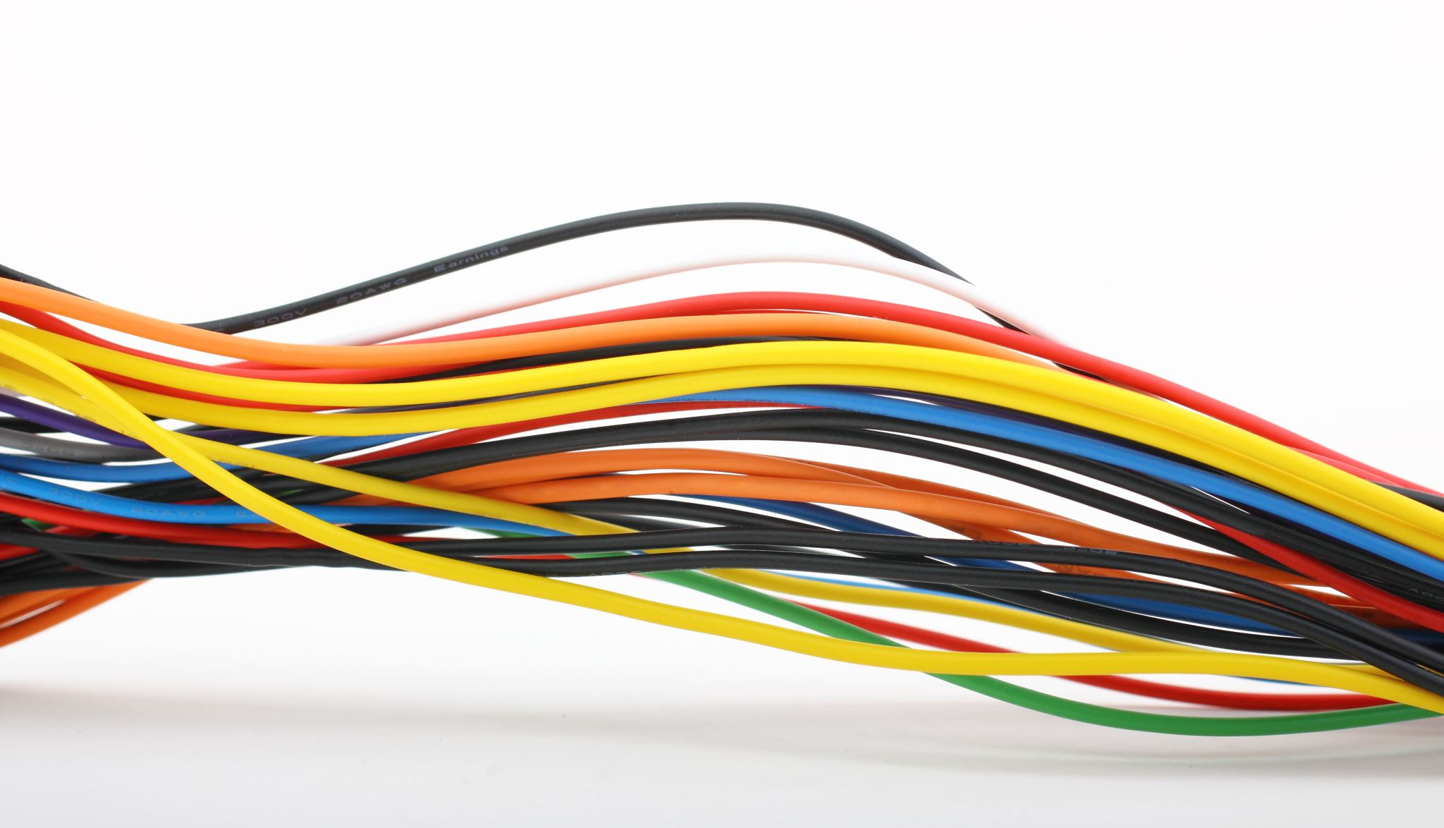
Components Required:
Hardware components:
Node MCU ESP8266 Breakout Board
Dual H-Bridge motor drivers L298
Jumper Wires(generic)
Arduino UNO
Battery Holder
Software application:
Arduino IDE

Slide 4

Working Principle
1. Wi-Fi communication:
(i) The ESP8266 is programmed as a web server or access point.
(ii) A smartphone or laptop connects to the ESP8266’s Wi-Fi network.
(iii) The user sends control commands via a web interface, mobile app, or HTTP request.
2. Command Processing:
(i) The ESP8266 receives movement commands such as forward, backward, left, right, and stop.
(ii) It processes these commands and sends signals to the motor driver module.
3. Motor Control:
(i) The motor driver controls the speed and direction of the DC motors based on the received signals and the car moves accordingly.

Slide 5

Setting up Blynk for ESP8266
Step 1: Install Blynk App
Download the Blynk App.
Sign up and create a new project
Select ESP8266 as the device and set the connection type to Wi-Fi
Get the Authentication Token via email.
Step 2: Install Blynk library in Arduino IDE
Open Arduino IDE
Go to sketch -> Include library -> Manage libraries
Download/ Install Blynk and ESP8266 libraries

Slide 6

Creating Blynk Dashboard
Open Blynk App
Add a Button widget
Add two datastreams, as virtual pins V0 and V1
Define the Blynk template id and template name

Slide 7
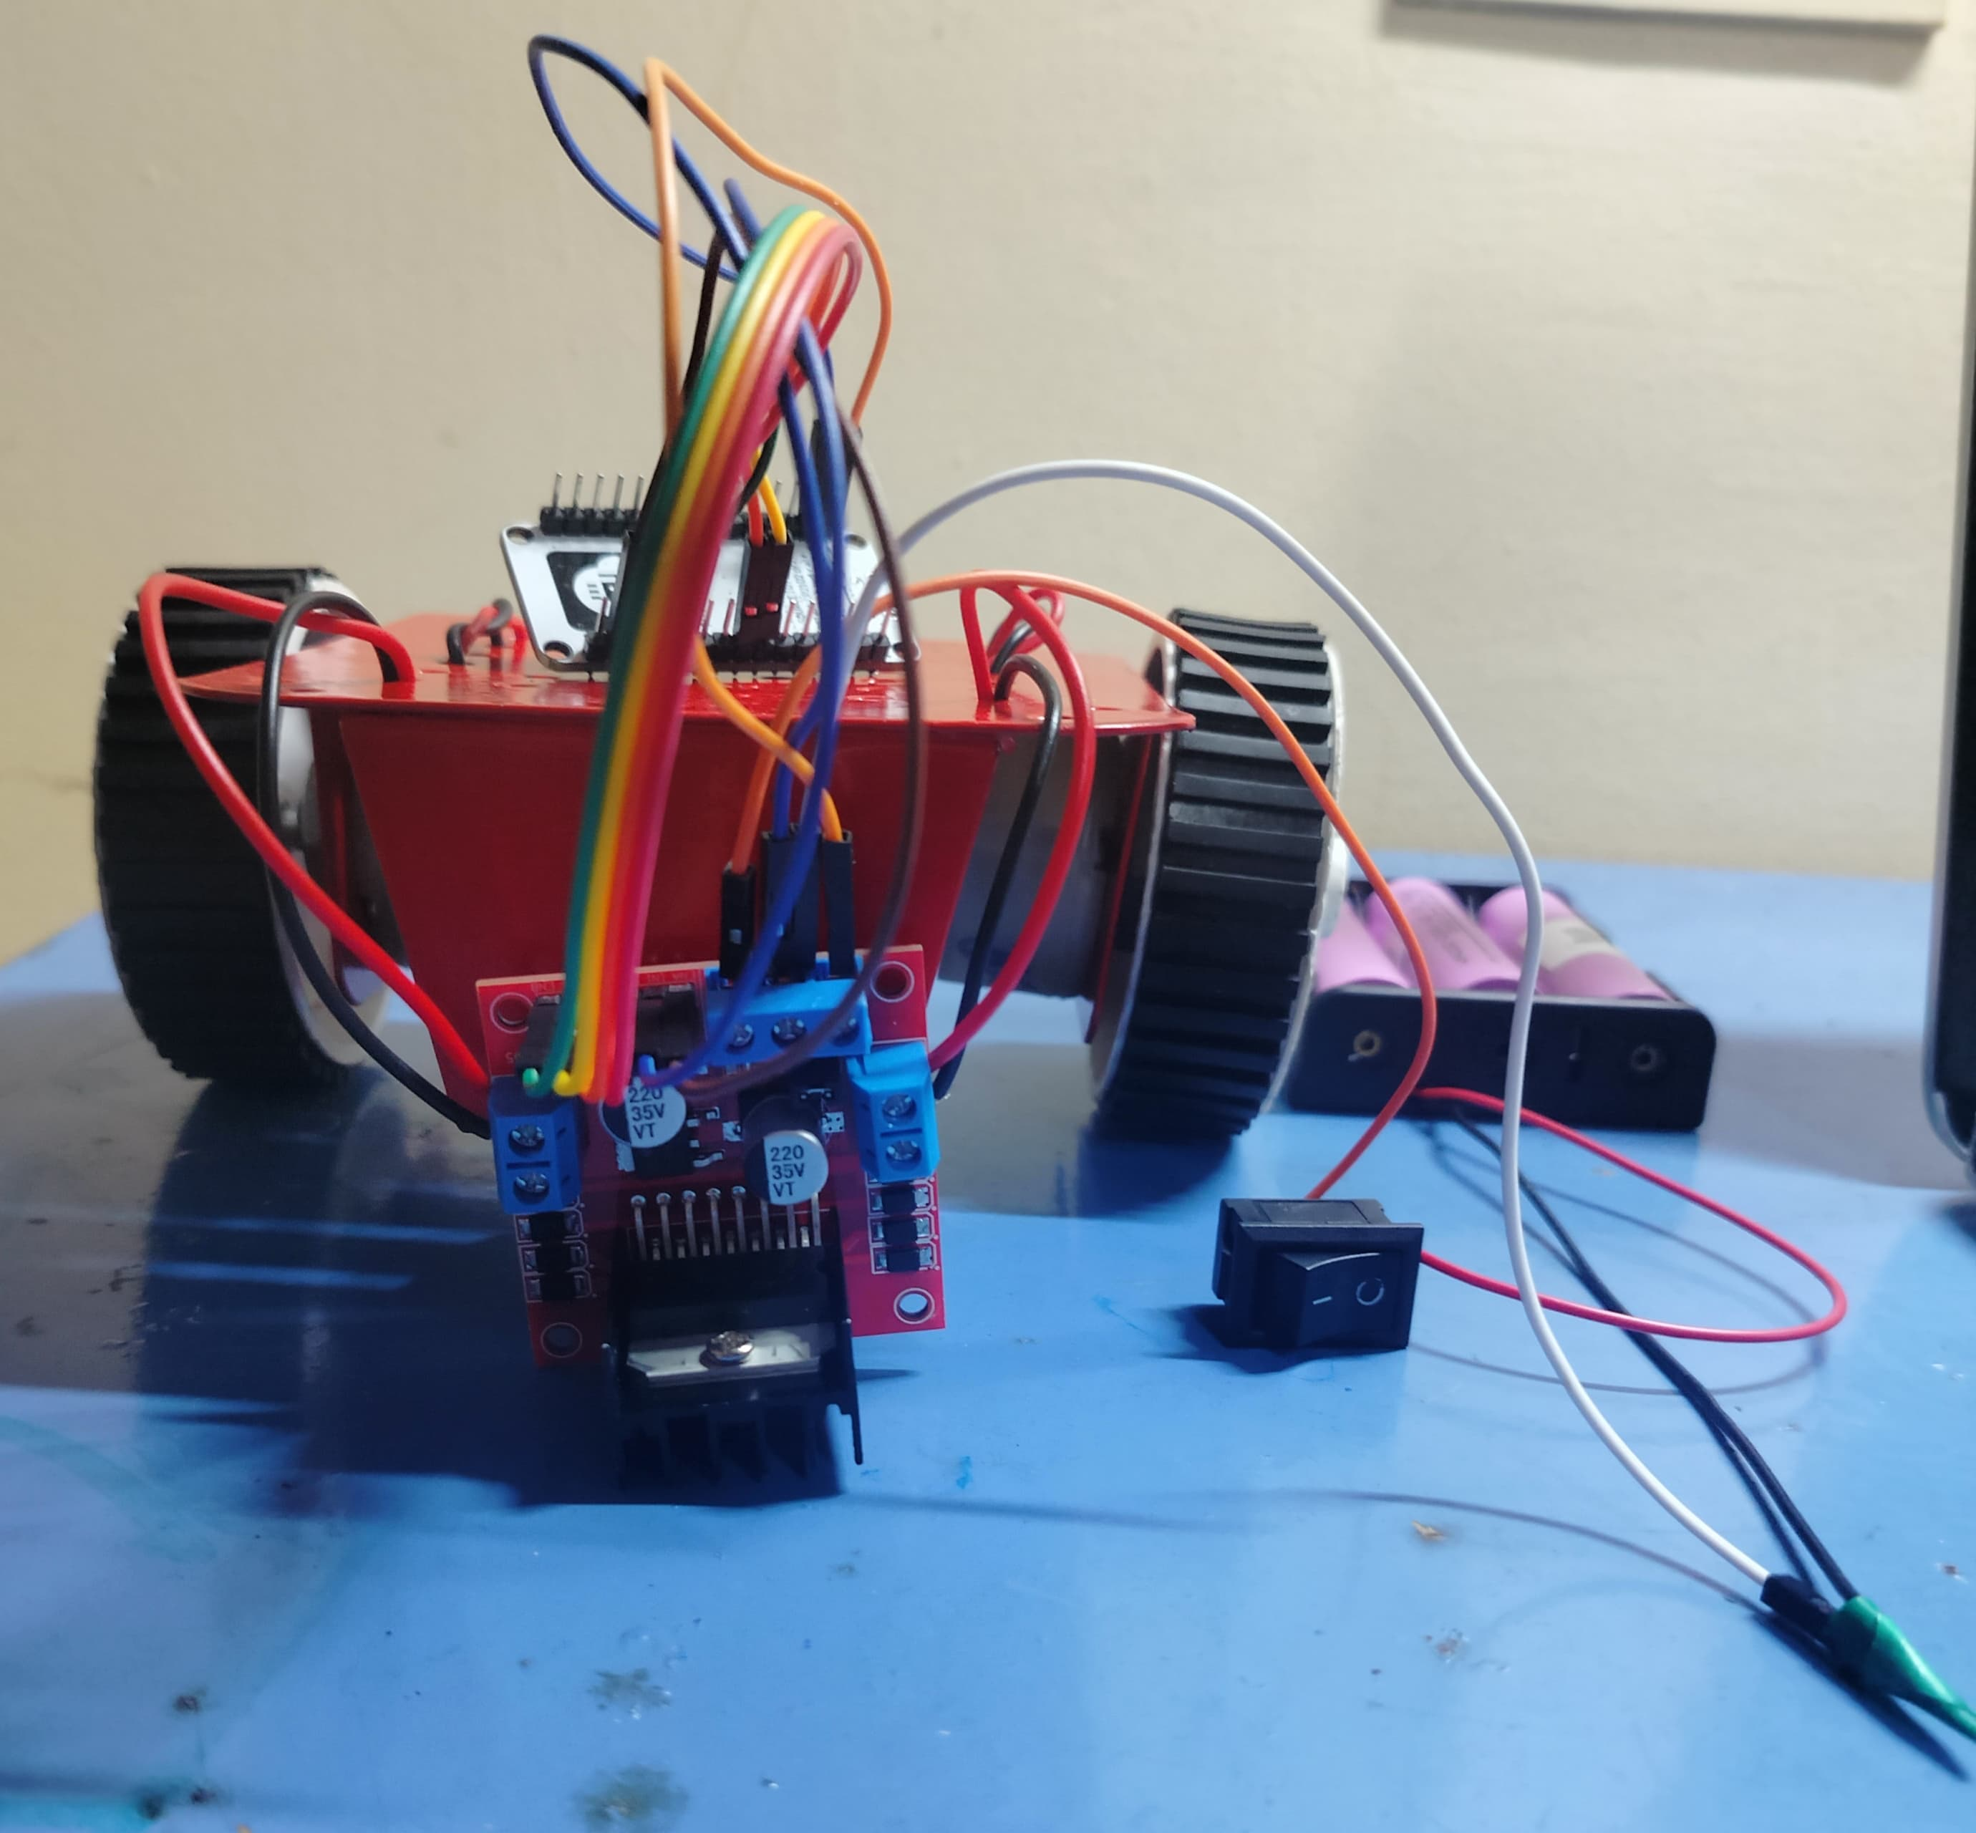
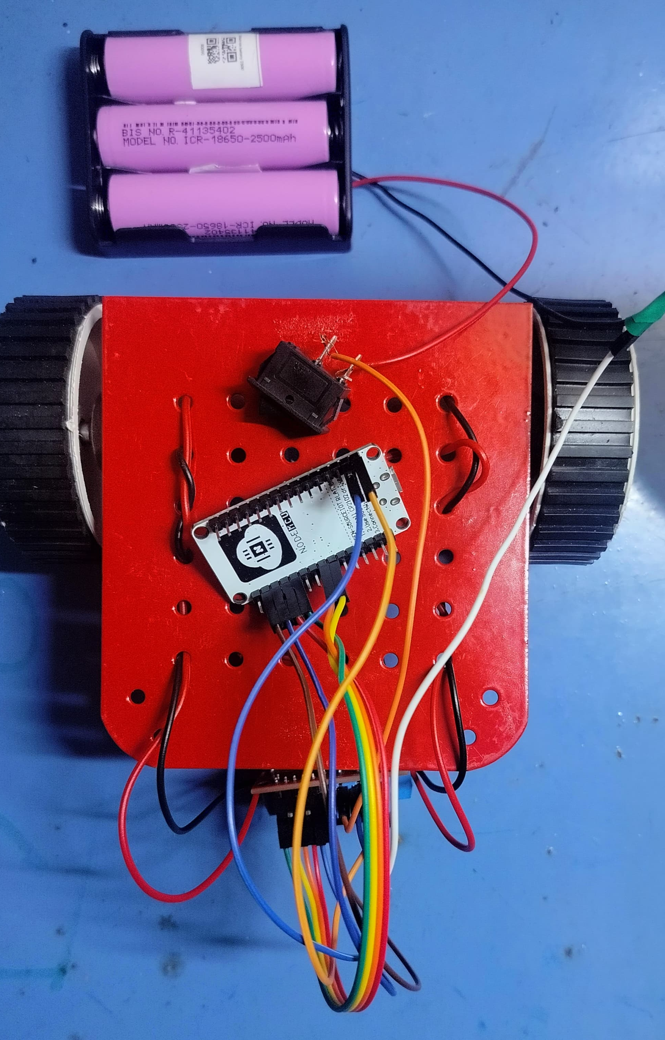
Design

Slide 8

Advantages:
Wireless Control – No need for Bluetooth, works over Wi-Fi.
Longer Range-Unlike Bluetooth, Wi-Fi provides better range and coverage.
Can be integrated with cloud platforms for automation.
Can be controlled via a mobile app or web page.

Slide 9

Applications:
Surveillance and Security robots
Smart home automation projects
IOT- based vehicle control systems
Educational robotics projects

Slide 10

THANK YOU!

